Slide 1
Data Representation
Data Representation refers to the form in which data is stored, processed, and transmitted
Binary
Unicode
Encryption
Images
Examples

Slide 2
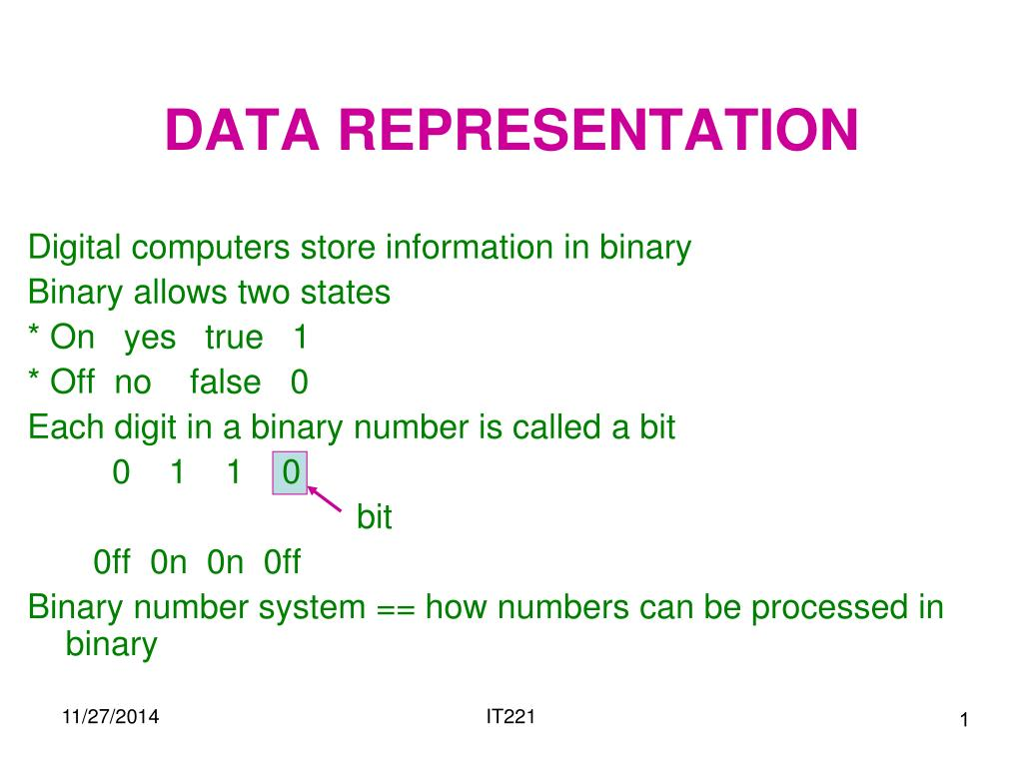
Data Representation
Binary
The atomic unit of data in computer systems is the bit, which is actually an
acronym that stands for Binary digit. It can hold only 2 values or states: 0
or 1, true or false therefore it can carry the smallest amount of meaningful
information possible¹.

Slide 3
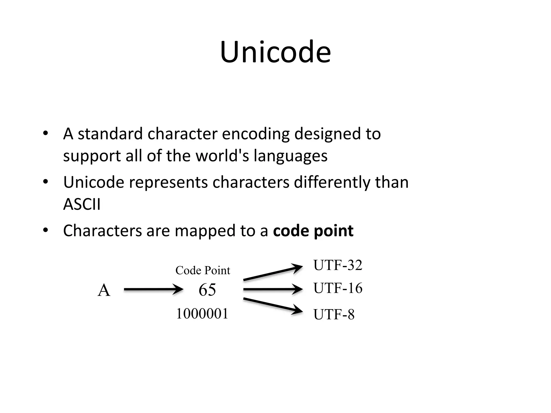
Data Representation
Unicode
Unicode uses two encoding forms: 8-bit and 16-bit, based on the data type of the data that is being that is being encoded. The default encoding form is 16-bit, where each character is 16 bits (2 bytes) wide. Sixteen-bit encoding form is usually shown as U+hhhh, where hhhh is the hexadecimal code point of the character².

Slide 4

Data Representation
Encryption
Data encryption converts data from a readable, plaintext format into an unreadable, encoded format: ciphertext. Users and processes can only read and process encrypted data after it is decrypted. The decryption key is secret, so it must be protected against unauthorized access³.

Slide 5
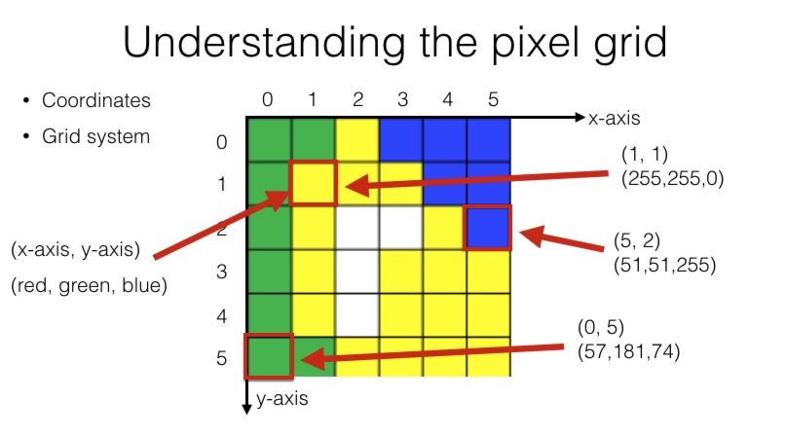
Data Representation
Images
The images types we will consider are: 1) binary, 2) gray-scale, 3) color, and 4) multispectral. Binary images are the simplest type of images and can take on two values, typically black and white, or 0 and 1. A binary image is referred to as a 1-bit image because it takes only 1 binary digit to represent each pixel⁴.

Slide 6
SOURCES CITED
The University of Edinburgh, https://www.inf.ed.ac.uk/teaching/courses/inf2c/lectures/CS02_notes.pdf
IBM Technology corporation, https://www.ibm.com/docs/en/db2/11.5?topic=support-unicode-character-encoding
Druva Software company, https://www.druva.com/glossary/what-is-data-encryption-definition-and-related-faqs
UOT - Iraq, https://uotechnology.edu.iq/ce/lecture%202013n/4th%20Image%20Processing%20_Lectures/DIP_Lecture2.pdf

